Slide 1

Forecasting NYC’s 311 Service
May 30, 2024
Presented by Rick Lataille

Slide 2
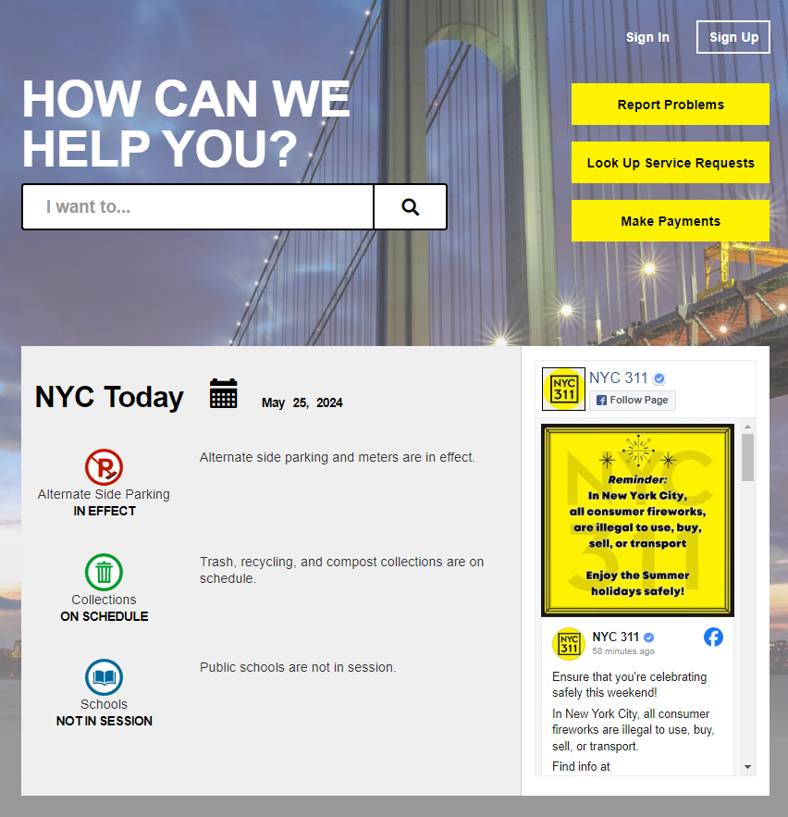
311 Connects NYC Residents to the City
Streamlines access to City
Reduces City’s costs
Improves quality of life
Improves satisfaction

Slide 3
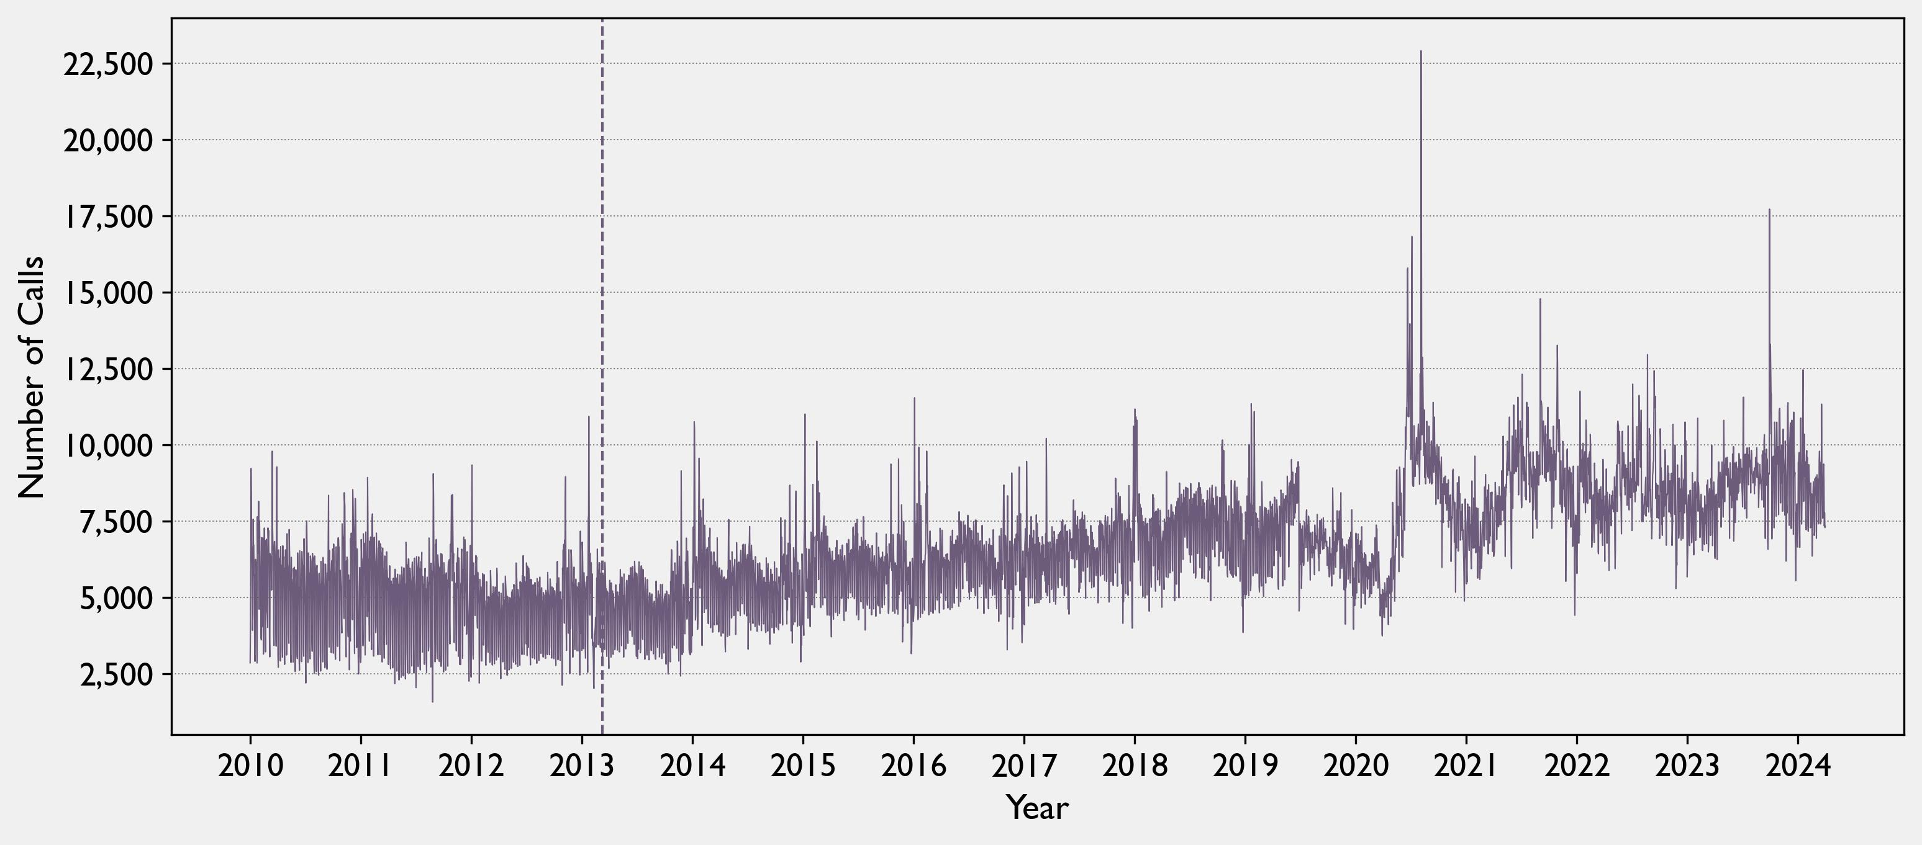
Usage is Increasing and Volatile
March 9, 2013
311 App Release
August 20, 2024
Hurricane Isaiah
22,904 calls

Slide 4
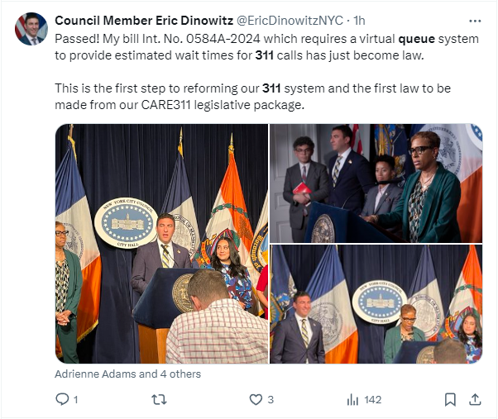
Expectations are High
Increased usage = longer wait times = Angry New Yorkers

Slide 5
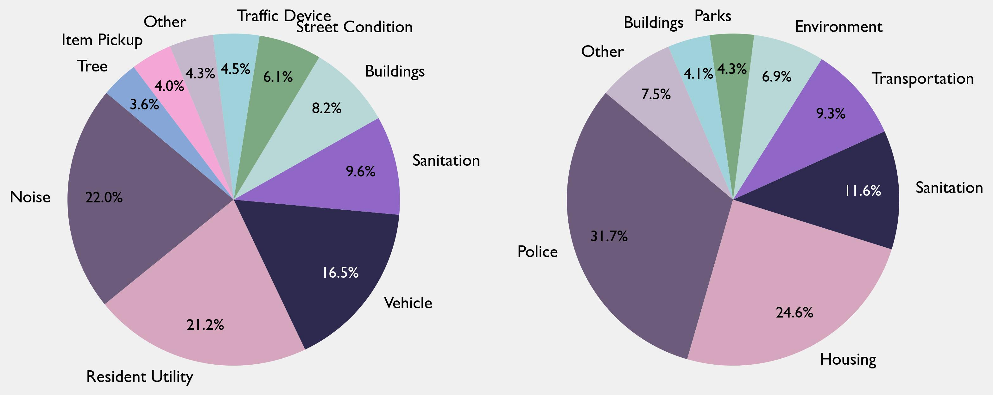
There are Many Agencies and Services…

Slide 6
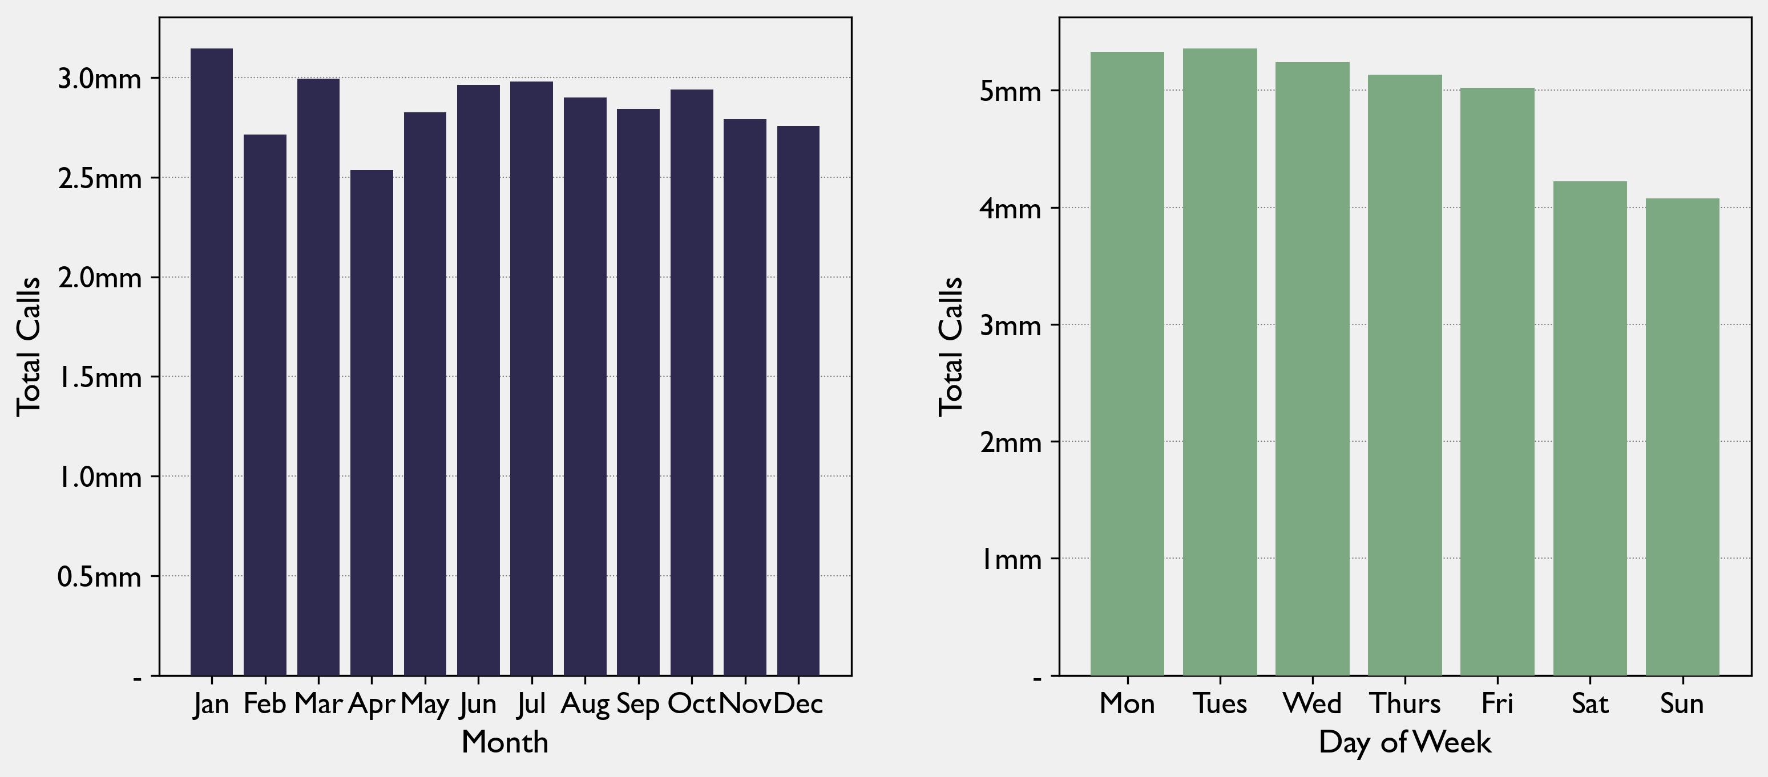
…With Limited Predictable Patterns

Slide 7
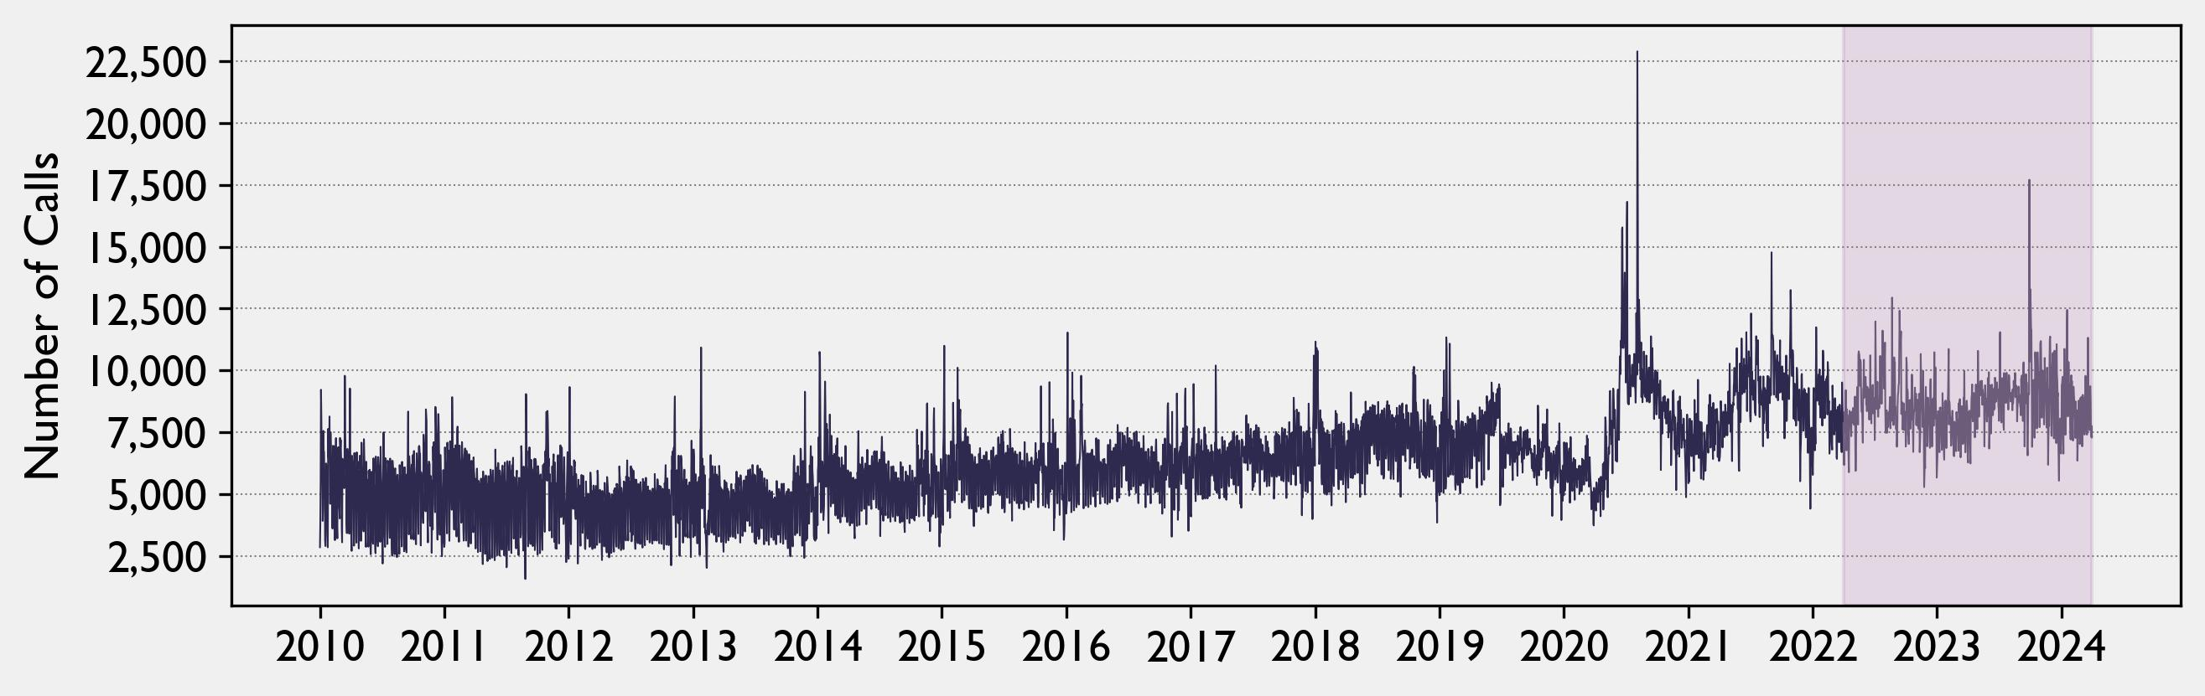
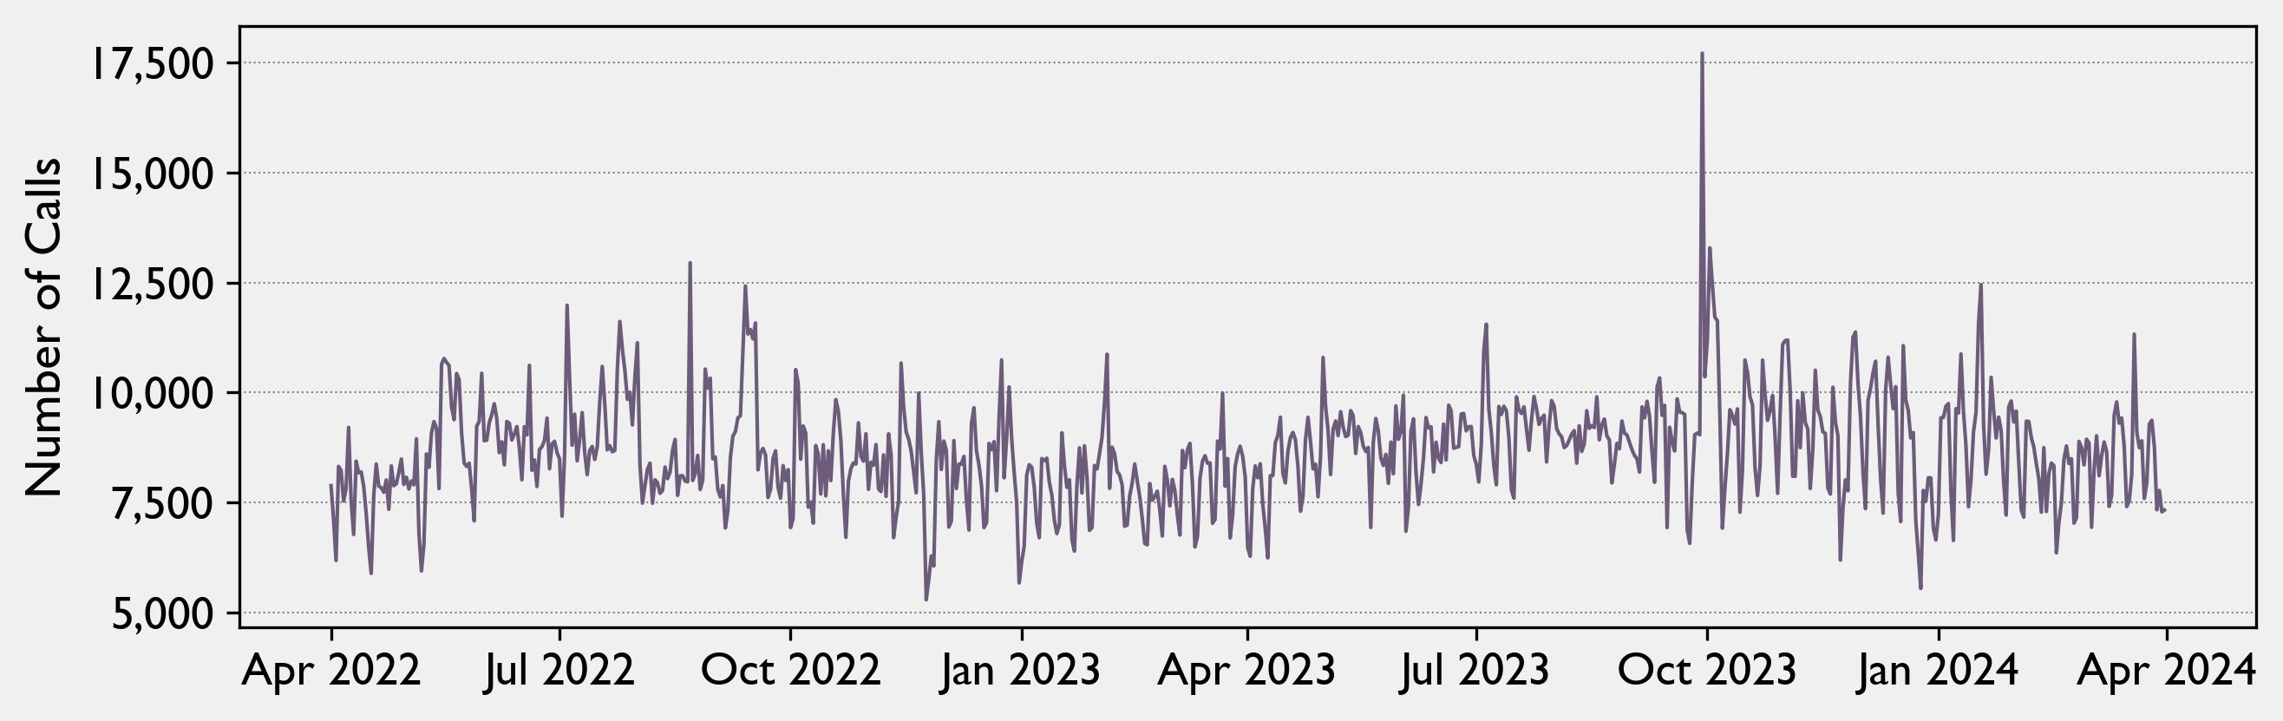
Goal: Forecast for Next Day, Week, Month
Daily forecast Operational planning
Weekly forecast Tactical planning
Monthly forecast Strategic planning

Slide 8
Daily Forecasting

Slide 9
Weekly Forecasting

Slide 10
Monthly Forecasting

Slide 11
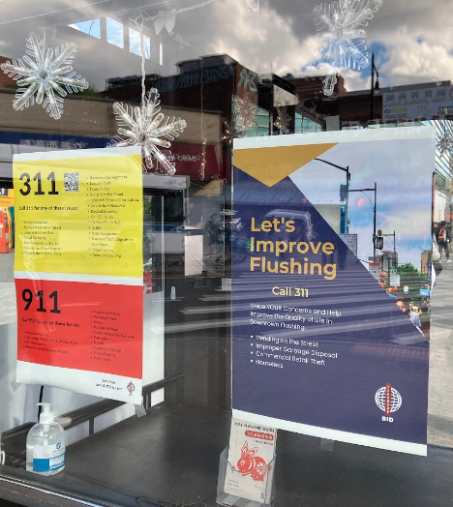
Steps for the Future
Decompose Dataset for Agency and Request Models
Geolocate Requests to Search for Covariants
Public Campaign to Enhance Usage to Enrich Data

Slide 12
Questions

